Slide 1
Portuguese Bank Marketing Project
Yadi Yang
Brown University
10/15/2021
https://github.com/skyyaya28/1030Marketing_Project.git
https://github.com/skyyaya28/1030Marketing_Project.git

Slide 2
Introduction
What - Predict if the client will subscribe to a term deposit (Classification)
Why - Assist in generating a larger cash flow for the bank
Data Source - Kaggle Competition
Data Parameter
20 Features and 1 Target Variable
41188 Entries

Slide 3
Data Breakdown
Client data
Age, job, marital status, education, credit default, housing, loan
Campaign related
Contact type, month since last contact, day of contact, contact duration
Additional Attributes
# of campaigns, days since last contact, # of previous contact, outcome of previous outcome
Socio Economic Attributes
Employment variation rate, consumer price and confidence index, employment indicators

Slide 4
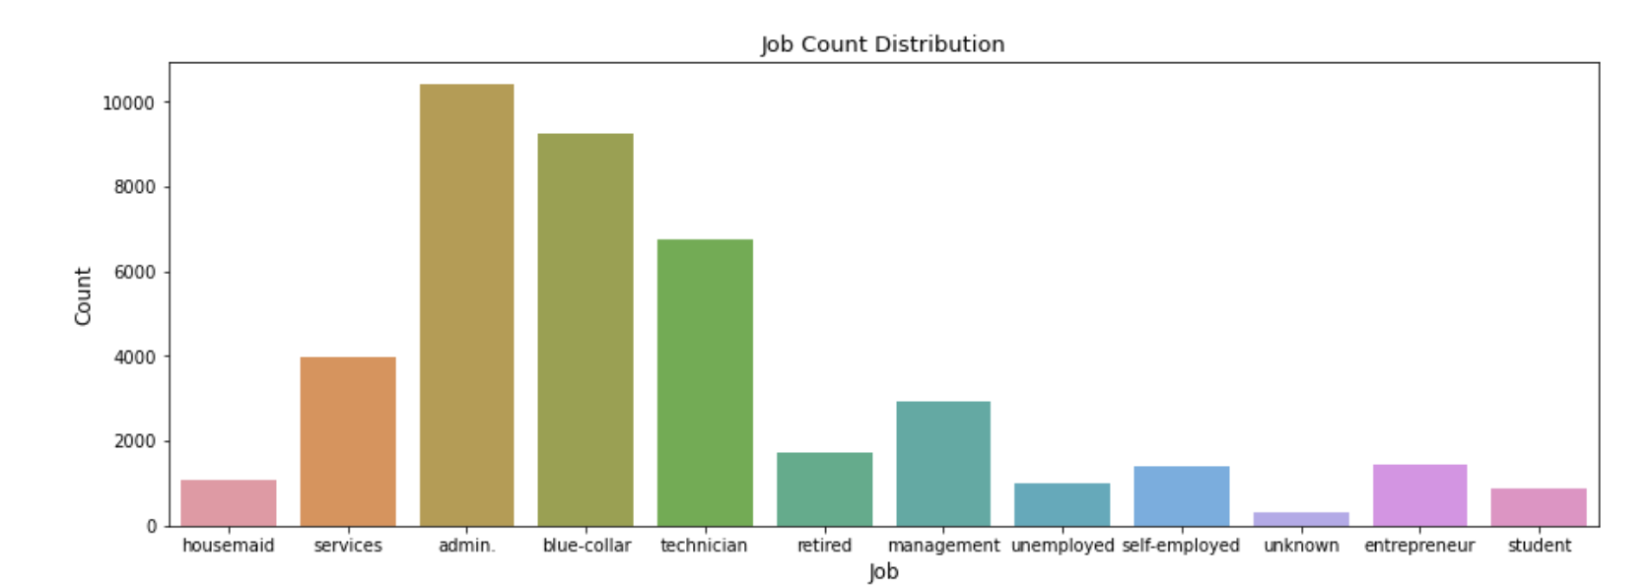
Exploratory Data Analysis

Slide 5
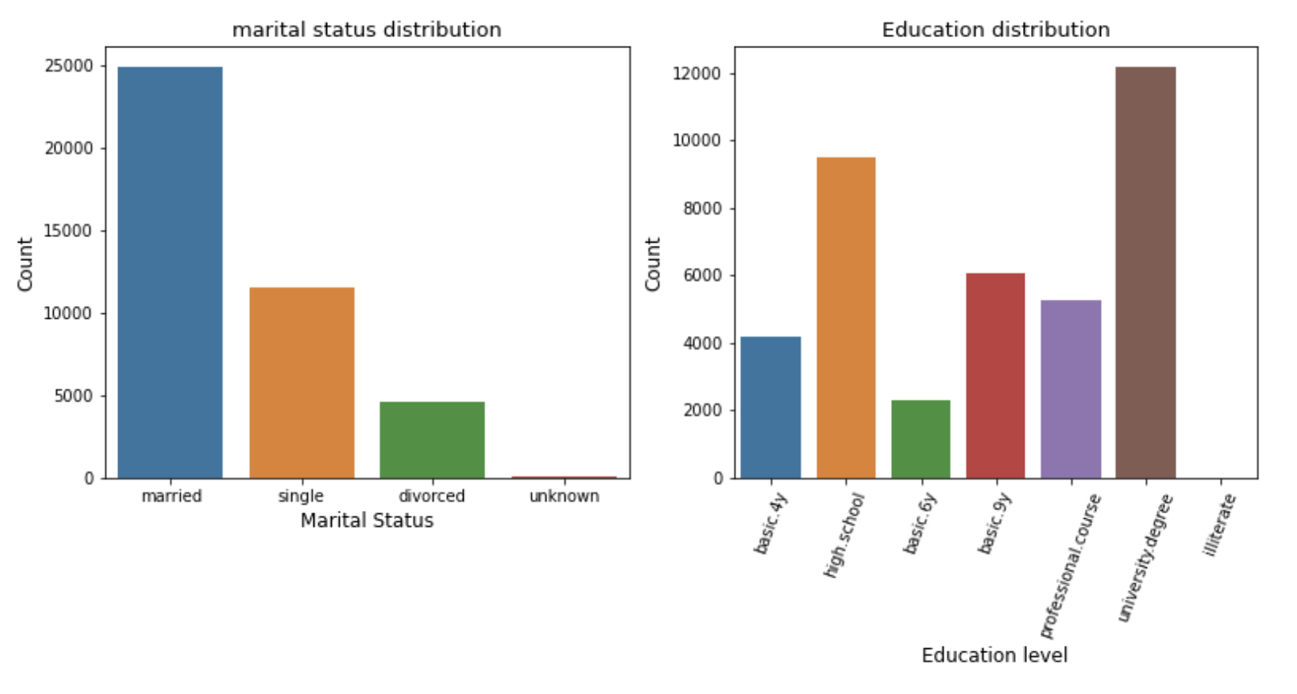
Exploratory Data Analysis

Slide 6
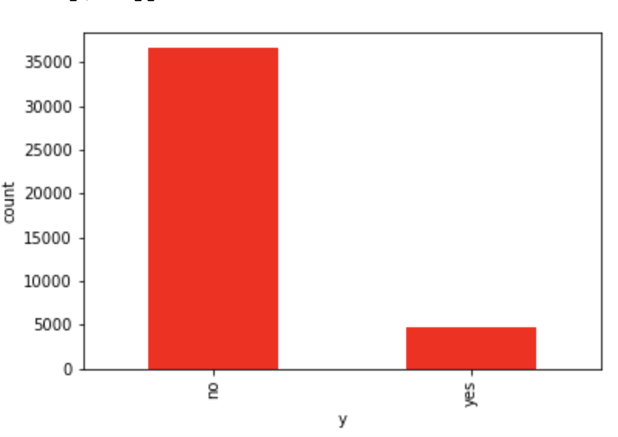
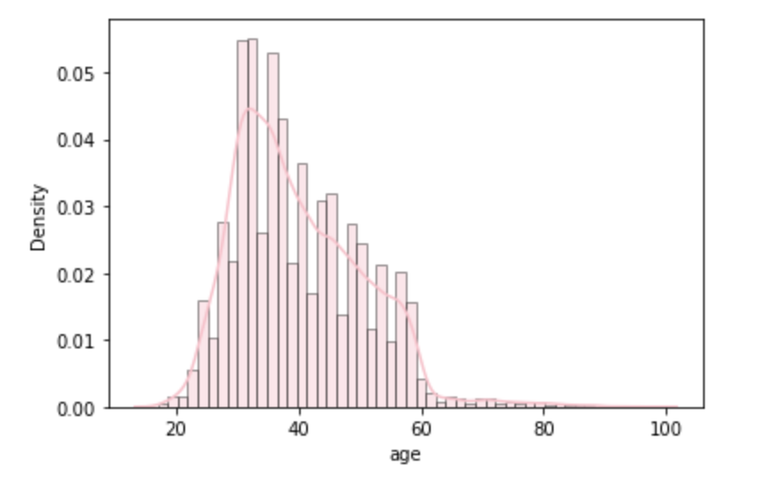
Unbalanced Data

Slide 7
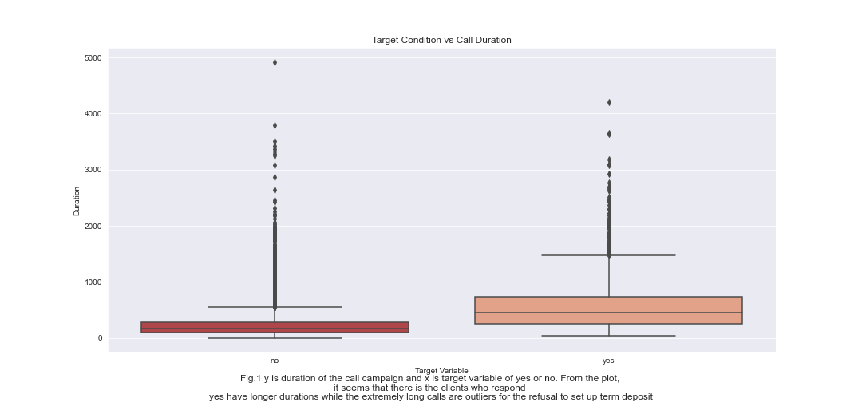
Exploratory Data Analysis

Slide 8
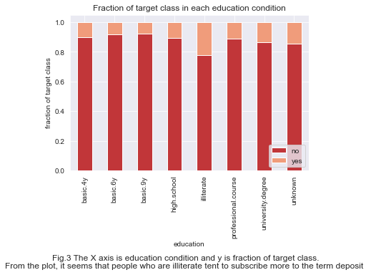
Exploratory Data Analysis

Slide 9
Splitting and Preprocessing
Train Test Split
90/10
Stratified Sampling
Fraction of Unknown values in features
education 0.042027
pdays 0.963217
Can’t afford to delete 8,597 rows in our dataset, it’s more than 20% of our observations
Unknown does not equal to missing

Slide 10
Splitting and Preprocessing
Min-Max Scaler
Age: Continuous yet bounded
Ordinal Encoder
Education: Categorical yet rankable
One Hot Encoder
Job, Marital Status, Default Status, Housing Loan, Personal Loan, Contact, Months, Days of Week, Campaign Outcome
Standard Scaler
Duration, Campaign, Employment variation rate, consumer price and confidence index, employment indicators

